Slide 1
Applications of Instance-Based Learning Theory: Using the SpeedyIBL Library to Construct Computational Models
CLIHC 2023, Puebla, Mexico Erin H. Bugbee Thuy Ngoc Nguyen Cleotilde Gonzalez

Slide 2
Agenda

Slide 3
Introduction to Instance-Based Learning Theory
Introduction to the SpeedyIBL Library with a Binary Choice Task Example
Building an IBL Model for the Iowa Gambling Task
Conclusion and Additional Applications

Slide 4
Introduction to Instance-Based Learning Theory

Slide 5
Complex, Dynamic Decision Making (DDM)

Slide 6

Dynamic and sequential multi-attribute decisions that are interdependent over-time
High uncertainty and change at different time scales
Dynamic allocation of limited resources (time, drones, people)
There is not enough time for considering all alternatives before making a choice
Human cognitive abilities (attention, memory) are limited

Slide 7
Machine AI and Complex Societal DDM Problems

Slide 8

Machine AI is supporting complex DDM problems in multiple ways — aggregating data, detecting patterns, and forecasting and projecting events based on data
But often there is not enough data, particularly regarding high-level decisions
Requires a deep understanding of context, consideration of multiple and possibly conflicting factors and their consequences
The incorporation of ethical and moral trade-offs

Slide 9
The ultimate responsibility for complex decisions lies, and will continue to lie, with humans.

Slide 10
Why Should Machines Learn?

Slide 11
Artificial intelligence has two goals.
First, AI is directed toward getting computers to be smart and do smart things so that human beings don’t have to do them.
And second, AI (sometimes called cognitive simulation, or information processing psychology) is also directed at using computers to simulate human beings, so that we can find out how humans work and perhaps can help them to be a little better in their work.
Herbert A. Simon, 1983

Slide 12
Cognitive AI

Slide 13
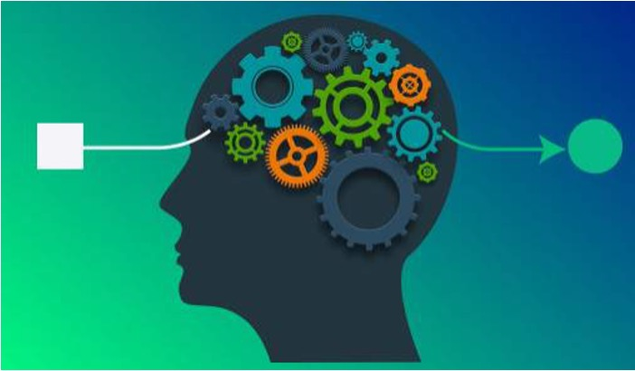
Cognitively-plausible algorithms that emulate human decision making
Based on cognitive theory: explain how humans make dynamic decisions, including the prediction of cognitive biases and errors in the absence of data
Dynamic actionable models: able to learn and adapt to changes independently to predict human decisions
Can represent human experience and be synchronized with human actions
Can become collaborators with humans in teams

Slide 14
Building Human-Like Artificial Agents using IBLT

Slide 15
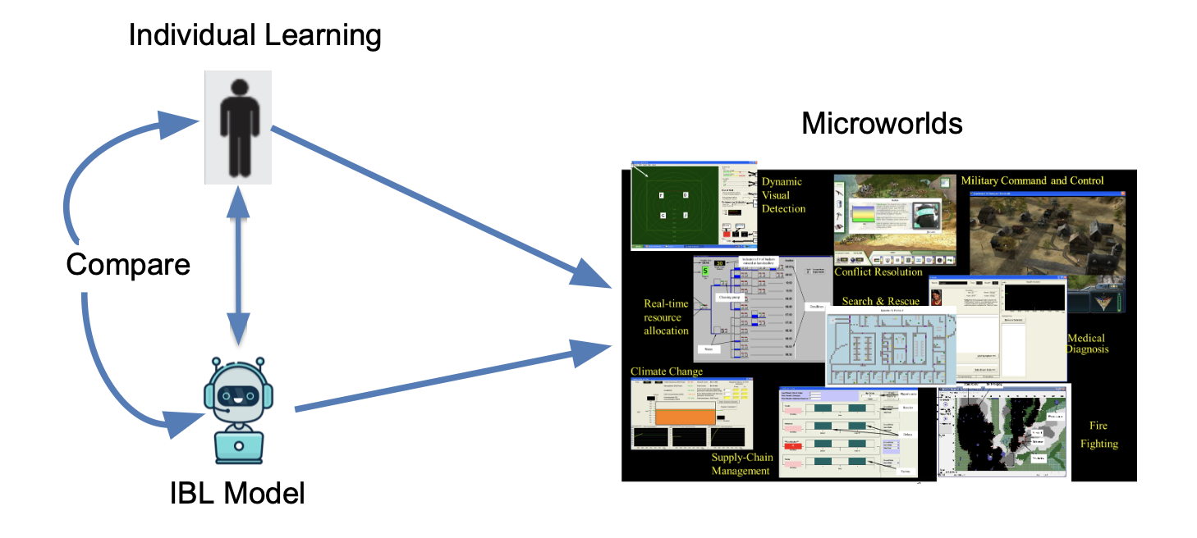

Slide 16
Demonstrate that IBLT is a GENERAL theory of Dynamic Decision Making and can replicate human decisions from experience (DfE)

Slide 17
Using Microworlds in Laboratory Experiments to Study DDM

Slide 18
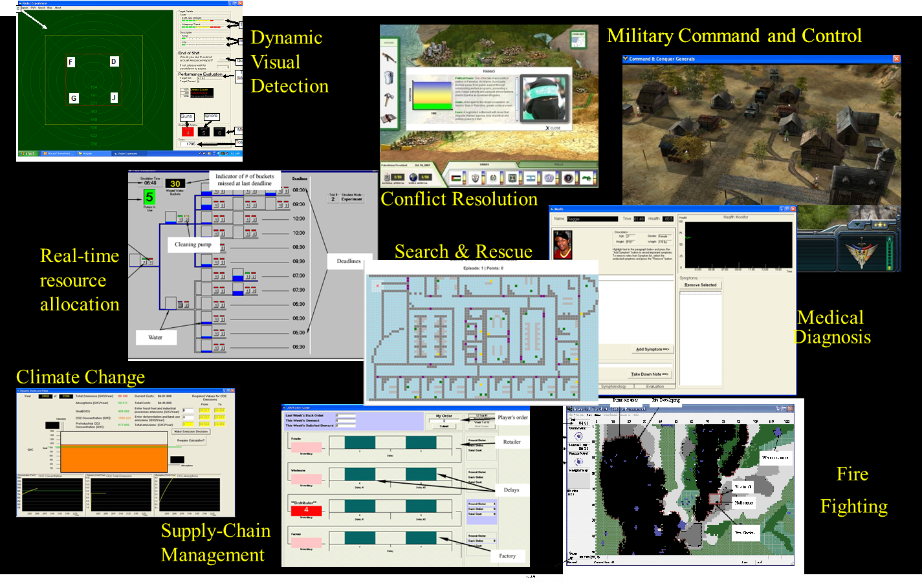

Slide 19
Approach: Cognitive Architectures

Slide 20
Allen Newell, 1990
Unified Theories of Cognition
A single system (mind) produces all aspects of human behavior
Representation of cognitive steps in performing a task
Explain how all the components of the mind worked to produce coherent cognition.

Slide 21
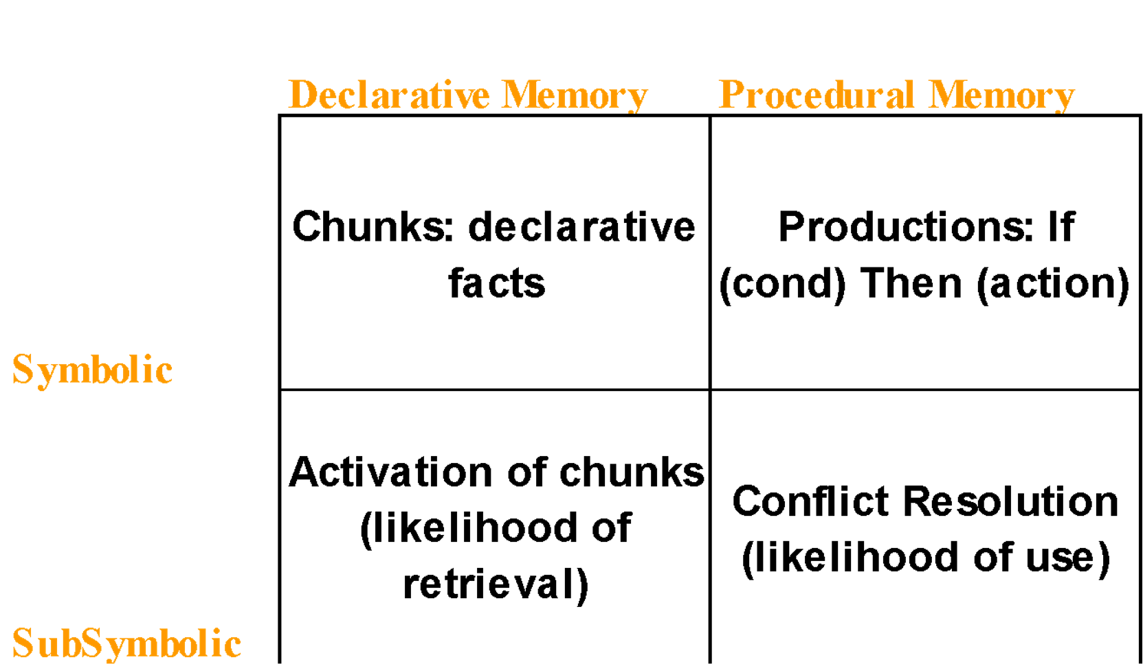
ACT-R: A unified theory of cognition (Anderson & Lebiere, 1998)

Slide 22
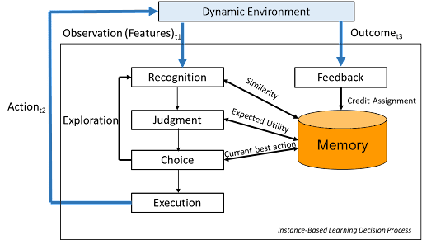
IBLT: Cognitive Algorithm for Dynamic Decision Making (Gonzalez et al., 2003)
Decisions are made by recognizing similar situations in decisions made in the past
Evaluating new actions according to the utility of past decisions
Mentally exploring the value of the alternatives sequentially
Executing a choice that has the maximum “expected utility”
Re-evaluating the utility of past decisions based on feedback from environment

Slide 23
Representation of Decisions

Slide 24
Decisions are stored over-time in memory (Instances) consisting of Contextual features, Action, Outcome (Utility)
For each potential Action instances are Blended accounting for similarity, to create an expected utility
The Action with the highest Blended Value is executed, and new instances are created.
The Blended Value is updated with an experienced outcome through feedback

Slide 25
IBLT Mathematical Mechanisms
$i=\text{instance}$
$k=\text{choice option}$
$t=\text{time}$
$j=\text{feature}$
Functions and Parameters
$ξ_{ik_{i}t}=\text{Draw from distribution}$
$α=\text{Mismatch Penalty}$
$σ=\text{Noise}$
$δ=\text{Decay}$
$τ=\text{Temperature}$

Slide 26
IBLT Mathematical Mechanisms
ACT-R’s Activation Equation
Λikit=lnt′∈Tikit​t−t′−d+
$$α∑jSim_{j}\left(f_{j}^{k},f_{j}^{k_{i}}\right)+$$
$$σln\frac{1−ξ_{ik_{i}t}}{ξ_{ik_{i}t}}$$

Slide 27
Probability of Retrieval
$$P_{ik_{i}t}=\frac{e^{Λ_{ik_{i}t}/τ}}{\sum_{j=1}^{n_{kt}}{e^{Λ_{jk_{j}t}/τ}}}$$
Blended Value
$$V_{kt}=\sum_{i=1}^{n_{kt}}{P_{ik_{i}t}}x_{ik_{i}t}$$
Action Selection
$$a_{l}=arg\max_{a∈A}V_{\left(s_{l},a\right),t}$$

Slide 28
Introduction to the SpeedyIBL Library with a Binary Choice Task Example

Slide 29
SpeedyIBL Library (Nguyen et al., 2022)

Slide 30


Slide 31
Motivation

Slide 32
An open-source, efficient library facilitates the implementation of models based on IBLT mechanisms
Demonstrate how to use SpeedyIBL to handle a diverse taxonomy of individual and multiagent decision-making tasks

Slide 33
Demonstrations

Slide 34
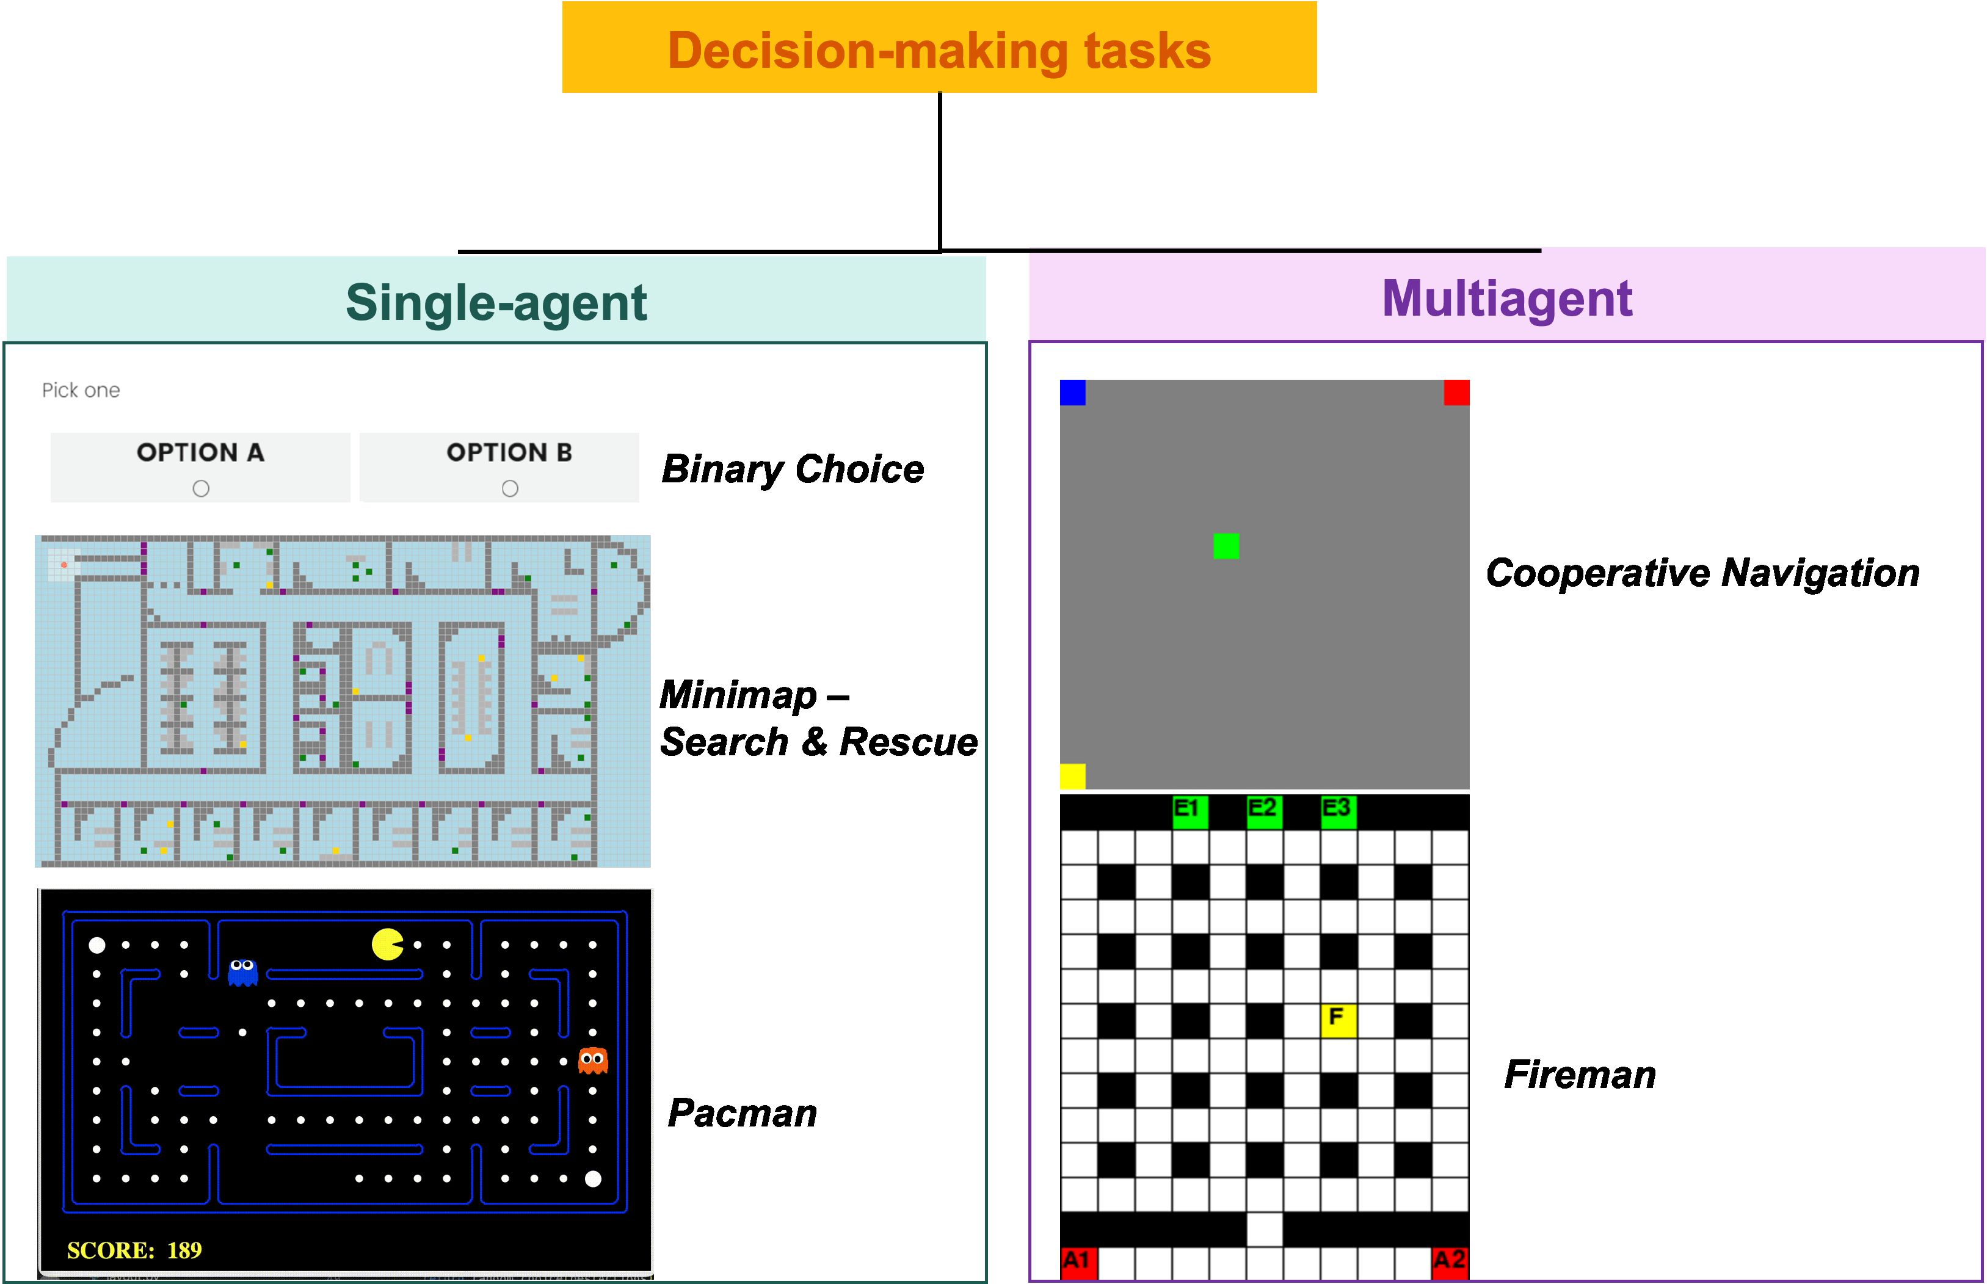

Slide 35
Notebook: 01_Introduction_SpeedyIBL.ipynb

Slide 36
Installing SpeedyIBL Library

Slide 37
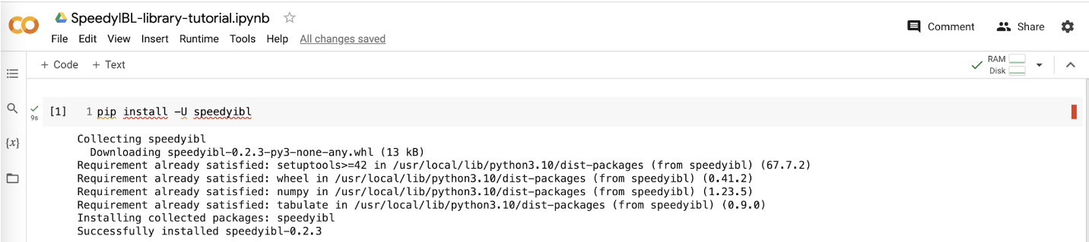
Using online Jupyter Notebook such as Google Colab:
pip install -U speedyibl

Slide 38
Installing SpeedyIBL Library

Slide 39
Running locally:
Must have Python 3 installed
(suggestion) Create a virtual Python Environment by running the following commands in your shell.
# Use venv module by entering the following commands in your shell: python3 -m venv env source env/bin/activate pip install -U speedyibl # OR use conda commands (with Miniconda/Anaconda installed): conda create -n myenv python=3.9 conda activate myenv pip install -U speedyibl

Slide 40
An IBL Agent with SpeedyIBL

Slide 41
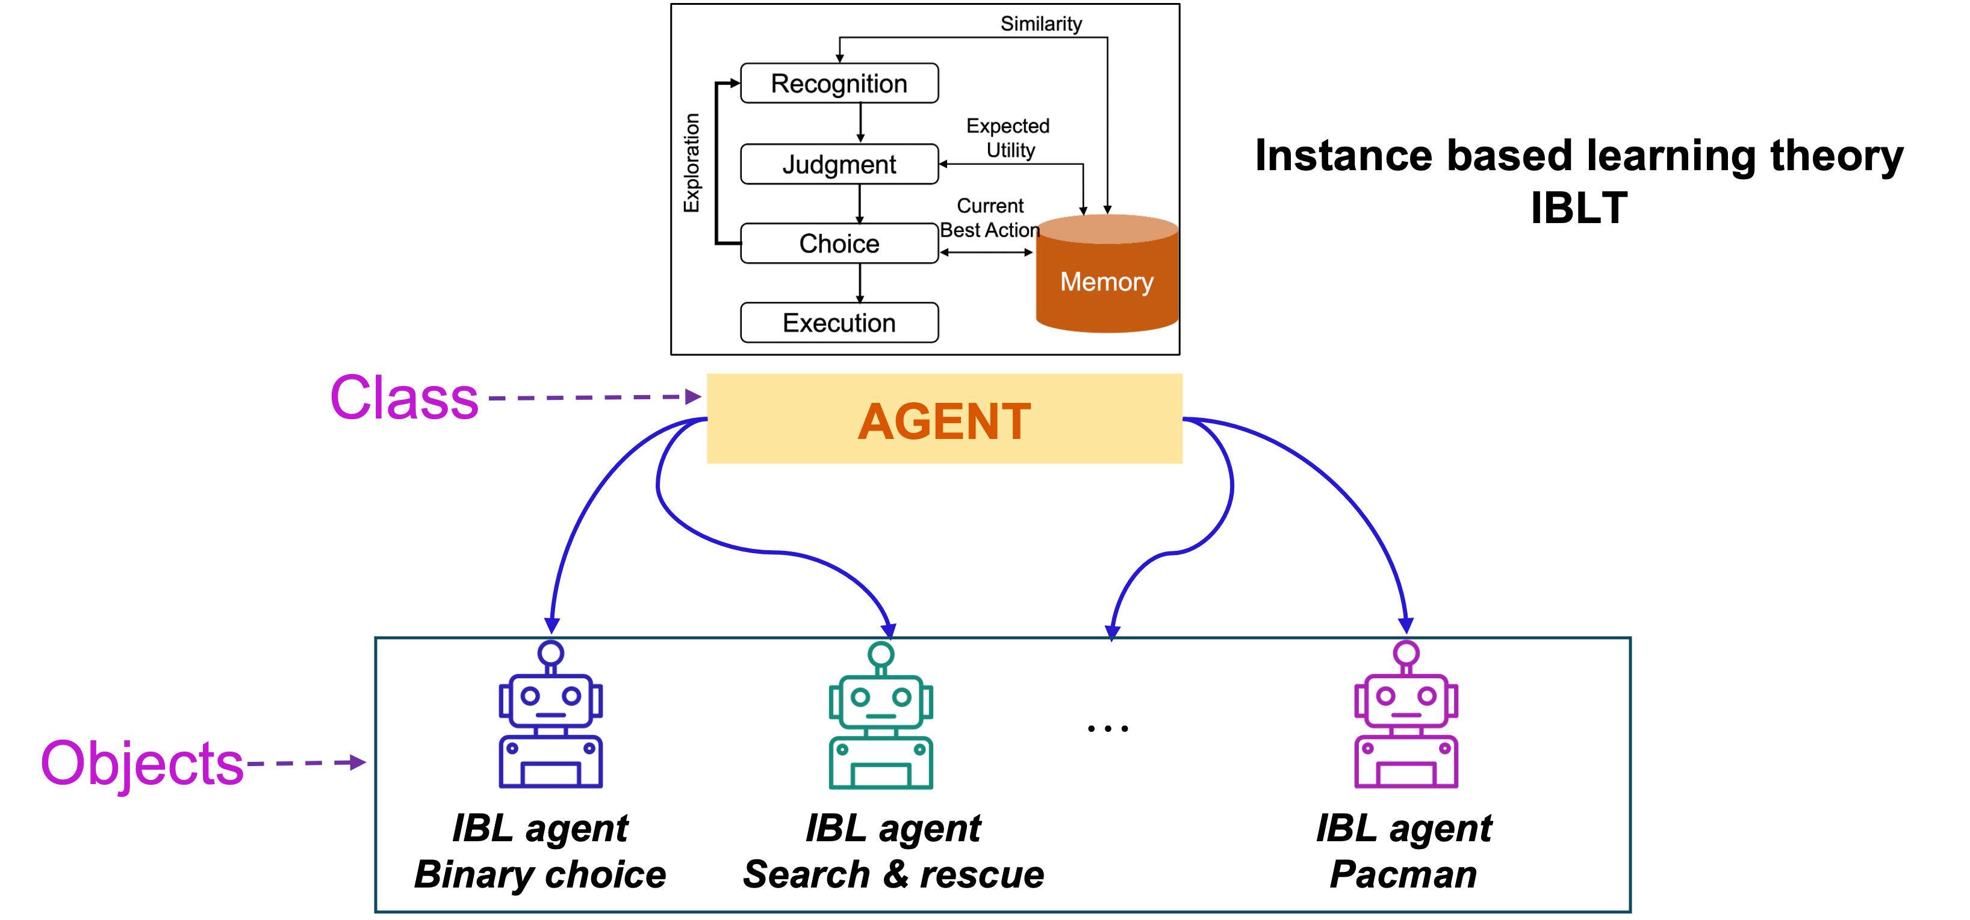
Import the class Agent from speedyibl
from speedyibl import Agent

Slide 42
Attributes (properties) of the class Agent

Slide 43
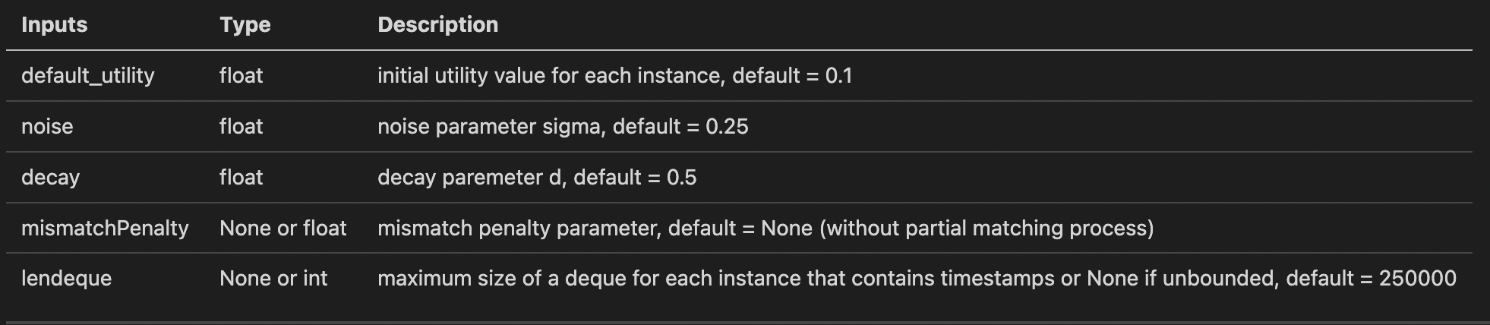

Slide 44
To view the list of attributes:
help(Agent.__init__)
Help on function __init__ in module speedyibl.speedyibl: __init__(self, default_utility=0.1, noise=0.25, decay=0.5, mismatchPenalty=None, outcome=True, lendeque=250000) Initialize self. See help(type(self)) for accurate signature.

Slide 45
Functions (methods) of the class Agent

Slide 46
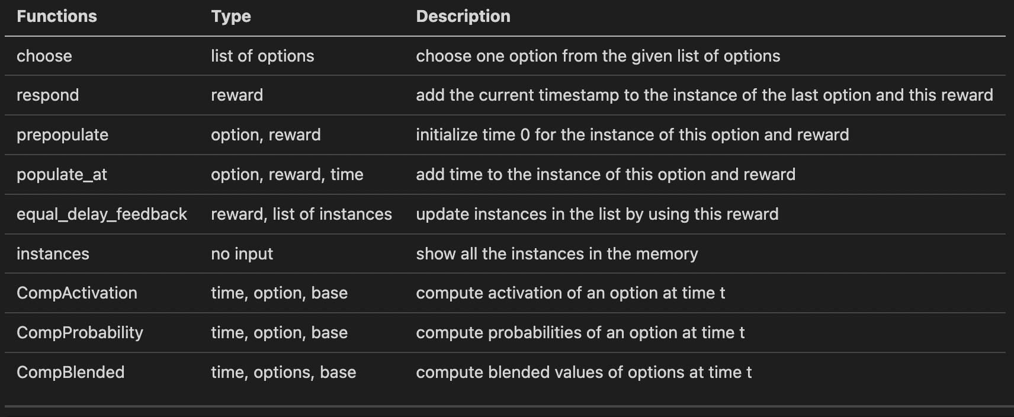

Slide 47
To display the list of methods:
dir(Agent)
['CompActivation', 'CompBlended', 'CompProbability', '__class__', '__delattr__', '__dict__', '__dir__', '__doc__', '__eq__', '__format__', '__ge__', '__getattribute__', '__gt__', '__hash__', '__init__', '__init_subclass__', '__le__', '__lt__', '__module__', '__ne__', '__new__', '__reduce__', '__reduce_ex__', '__repr__', '__setattr__', '__sizeof__', '__str__', '__subclasshook__', '__weakref__', 'choose', 'equal_delay_feedback', 'get_similarity', 'instances', 'make_noise', 'mkid', 'populate_at', 'prepopulate', 'reset', 'respond', 'similarity']
vars(Agent)
mappingproxy({'__module__': 'speedyibl.speedyibl', 'mkid': 0, '__init__': <function Agent.__init__ at 0x10a0d7430>, 'respond': <function Agent.respond at 0x10a16f1f0>, 'populate_at': <function Agent.populate_at at 0x10a16f280>, 'make_noise': <function Agent.make_noise at 0x10a16f310>, 'choose': <function Agent.choose at 0x10a16f3a0>, 'reset': <function Agent.reset at 0x10a16f430>, 'instances': <function Agent.instances at 0x10a16f4c0>, 'prepopulate': <function Agent.prepopulate at 0x10a16f550>, 'similarity': <function Agent.similarity at 0x10a16f5e0>, 'get_similarity': <function Agent.get_similarity at 0x10a16f670>, 'equal_delay_feedback': <function Agent.equal_delay_feedback at 0x10a16f700>, 'CompActivation': <function Agent.CompActivation at 0x10a16f790>, 'CompProbability': <function Agent.CompProbability at 0x10a16f820>, 'CompBlended': <function Agent.CompBlended at 0x10a16f8b0>, '__dict__': <attribute '__dict__' of 'Agent' objects>, '__weakref__': <attribute '__weakref__' of 'Agent' objects>, '__doc__': None})

Slide 48
SpeedyIBL for Binary Choice Task

Slide 49


Slide 50
Notebook: 02_Exercise_BinaryChoice.ipynb

Slide 51
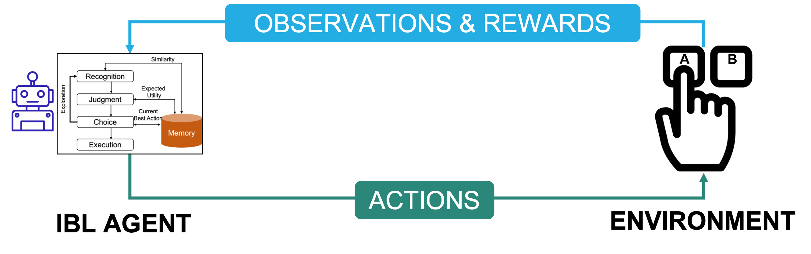
The Binary Choice Task

Slide 52
Choose one of two options: Option A or Option B
One option is SAFE, always yielding a fixed medium outcome (3)
One option is RISKY, yielding a high outcome (4) with probability of 0.8, and a low outcome (0) with the complementary probability of 0.2
Single-state with immediate feedback task

Slide 53
Create an Environment for the Binary Choice Task

Slide 54


Slide 55
Defining Options
Define a list of options for the agent to choose
options = ['A', 'B'] # A is the safe option while B is the risky one

Slide 56
Defining Reward
Define the reward for choosing an option
import random def reward(choice): if choice == 'A': r = 3 elif random.random() <= 0.8: r = 4 else: r = 0 return r

Slide 57
Putting Together in Class BinaryChoice
import random class BinaryChoice: def __init__(self): self.options = ['A', 'B'] def reward(self, choice): if choice == 'A': r = 3 elif random.random() <= 0.8: r = 4 else: r = 0 return r

Slide 58
Declare an Environment
env = BinaryChoice()

Slide 59
Building an Agent for the Binary Choice Task
Create an IBL agent for the binary choice task:
Indicating a value of default_utility
from speedyibl import Agent agent = Agent(default_utility = 4.4)
Indicating values for parameters, e.g. noise and decay
agent = Agent(default_utility = 4.4, noise = 0.1, decay = 0.8)

Slide 60
Interactions Between the Agent and the Task: Actions

Slide 61
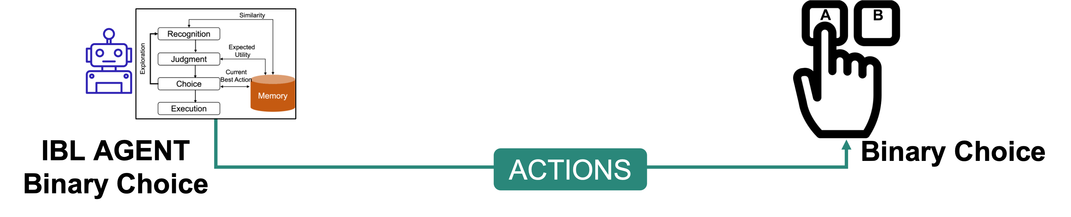

Slide 62
Choose Option
Make the agent choose one of two options:
choice = agent.choose(env.options)

Slide 63
Interactions Between the Agent and the Task: Observations and Rewards

Slide 64
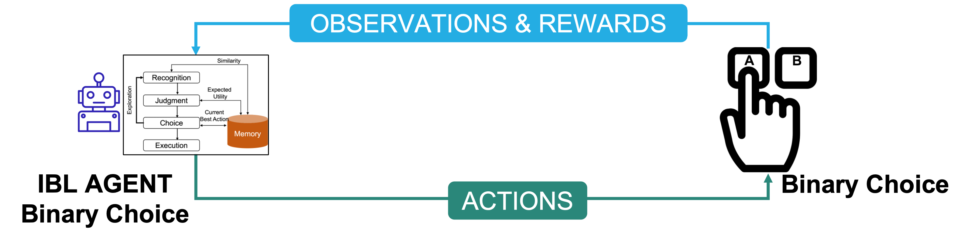

Slide 65
Observe Reward
After choosing one option, the agent observes the reward and stores an instance in memory using the function respond:
r = env.reward(choice) agent.respond(r)

Slide 66
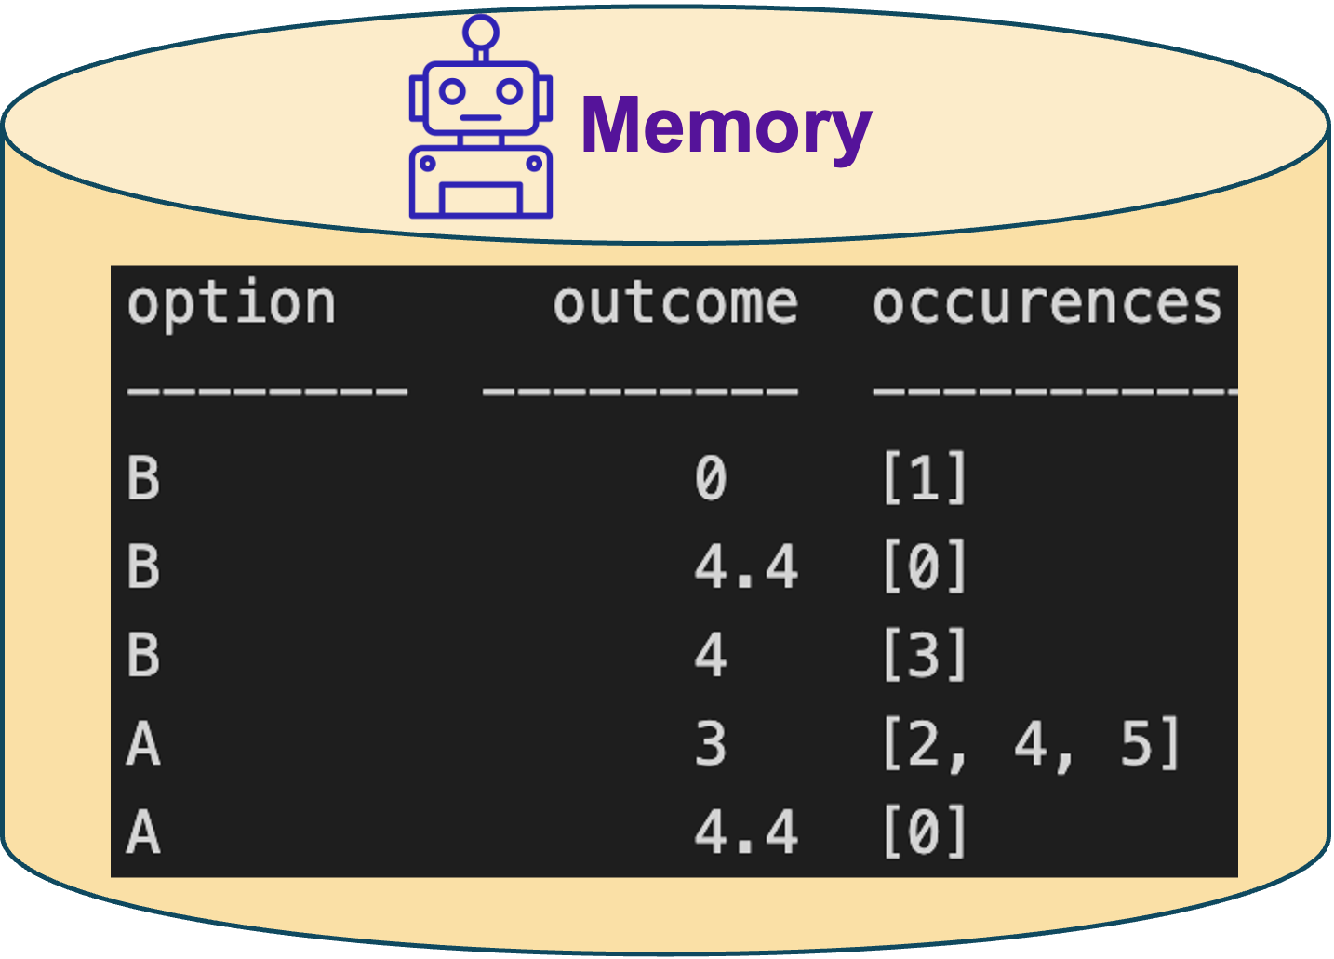
View the Agent’s Memory
To see how instances are stored in the memory
agent.instances()
option outcome occurences -------- --------- ------------ B 4 [1] B 4.4 [0]
Example:

Slide 67
IBL Agent’s Decision Mechanisms

Slide 68
Activation of Each Instance
print(agent.CompActivation(agent.t+1, 'A'))
(array([-0.63879114]), array([4.4]))
print(agent.CompActivation(agent.t+1, 'B'))
(array([ 0.32446812, -0.55245341]), array([4. , 4.4]))

Slide 69
Probability of Retrieving Each Instance
print(agent.CompProbability(agent.t+1, "A"))
(array([1.]), array([4.4]))
print(agent.CompProbability(agent.t+1, "B"))
(array([0.96723769, 0.03276231]), array([4. , 4.4]))

Slide 70
Blended Value for Each Option
print(agent.CompBlended(agent.t+1, env.options))
[(4.4, 0), (4.164837521731296, 1)]

Slide 71
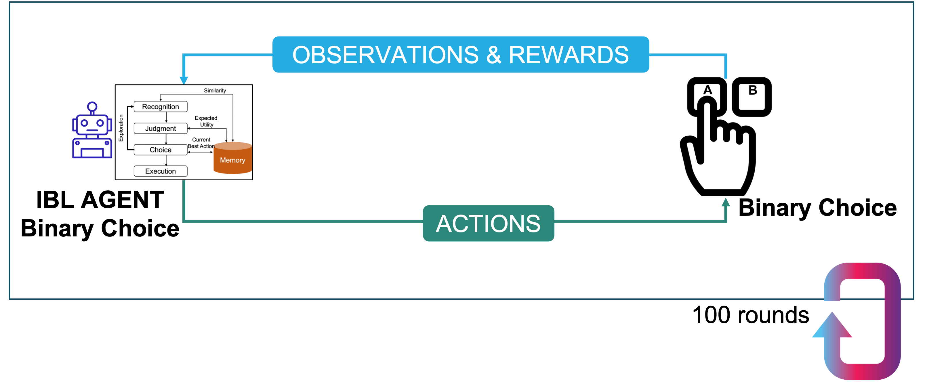
Simulating Choices for Many Rounds
Let the agent play 100 rounds (trials) for the binary choice task
Each round includes choosing one option, observing the reward, and storing the instance

Slide 72
Simulating Choices for Many Rounds: Code
rounds = 100 # number of rounds (trials) pmax = [] for i in range(rounds): choice = agent.choose(env.options) # choose one option from the list of options r = env.reward(choice) # observe the reward agent.respond(r) # store the instance pmax.append(choice == 'B') print(f"P(Max): {sum(pmax)/rounds}")
P(Max): 0.94

Slide 73
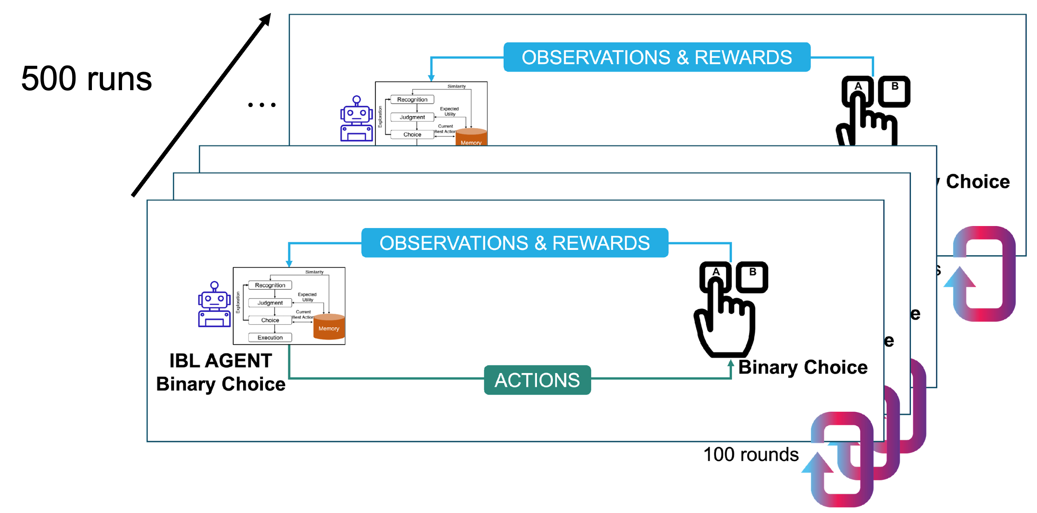
Simulating Choices for Many Runs
Let’s have 500 runs (500 subjects) playing 100 rounds of the task

Slide 74
Simulating Choices for Many Runs: Code
runs = 500 rounds = 100 # number of rounds (trials) pmax_per_run = [] for j in range(runs): pmax = [] agent.reset() # clear the memory for a new run for i in range(rounds): choice = agent.choose(env.options) # choose one option from the list of options r = env.reward(choice) # observe the reward agent.respond(r) # store the instance pmax.append(choice == 'B') pmax_per_run.append(pmax)

Slide 75
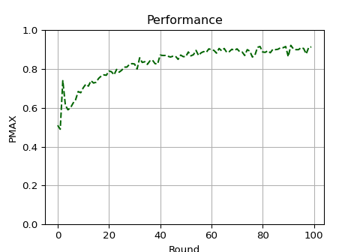
Plotting Performance (PMAX) over Rounds
import matplotlib.pyplot as plt import numpy as np plt.figure(figsize=(5, 3.5)) plt.plot(range(rounds), np.mean(pmax_per_run,axis=0), color='darkgreen', markersize=2, linestyle='--', label='speedyIBL') plt.xlabel('Round') plt.ylabel('PMAX') plt.title('Performance') plt.ylim(0,1)
(0.0, 1.0)
plt.grid(True) plt.show()

Slide 76
Exercise 1

Slide 77
Simulate the effect of the IBL model inputs in the Binary Choice Task
default_utility of 3, noise of 0.25, and decay of 0.5
default_utility of 4.4, noise of 0.5, and decay of 0.8

Slide 78
Exercise 2

Slide 79
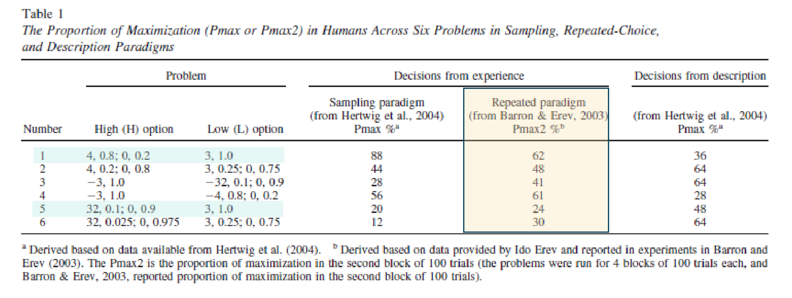
The table below from (Hertwig et al., 2004) presents the proportion of maximization obtained from experimentation in Humans
Simulate the Problem 5
Compare the IBL agents’ PMAX vs. Humans’ PMAX (Pmax2 column)

Slide 80
Building an IBL Model for the Iowa Gambling Task

Slide 81
Iowa Gambling Task History

Slide 82
Developed by researchers to study risky decision making (Bechara et al., 1994)
Widely used to study human cognition

Slide 83
Iowa Gambling Task Demo

Slide 84
To play the demo of game: https://www.psytoolkit.org/experiment-library/igt.html
4 decks of cards (A, B, C, and D).
Participants started with a “loan” of $2000 and were told to make a profit.
. . .

Slide 85
Iowa Gambling Task: Choices

Slide 86
Participants had to choose 100 cards in total, one at the time. Each time they choose a card, they get feedback about winning and/or losing some money.
They did not know what each card would yield in advance (i.e., a lottery).

Slide 87
Task Environment

Slide 88
Decks A and B always yielded $100
Decks C and D always yielded $50
For each card chosen, there is a 50% chance of having to pay a penalty as well. For decks A and B, the penalty is $250, whereas for decks C and D it is $50.

Slide 89
Notebook: 03_Exercise_IowaGambling.ipynb

Slide 90
Steps
Install and import speedyibl
Define an IBL agent
Define list of options
Choose option from list of options
Store the observed reward to memory of the agent

Slide 91
Steps

Slide 92
Run the simulation and observe the plots for default_utility=110 and default_utility=10
Vary the noise and decay parameters and plot the PMAX and AverageReward over rounds with default_utility=110
Run the simulation for varied parameter values and plot results

Slide 93
Notebook: 04_Solution_IowaGambling.ipynb

Slide 94
Conclusion

Slide 95
Additional Applications

Slide 96
Gridworld

Slide 97
A sequential decision making problem wherein a decision maker navigates through a grid by making sequential decisions about which actions to take (Up, Down, Left, Right) to search for a target and avoid obstacles
Dimension of environment: 3 x 4 grid that contains an obstacle (black cell)
Decision maker starts at an initial position (marked Start) and has a 25-step limit
One target which yields 1 point if the decision maker found it

Slide 98
IBL Model for Gridworld Environment

Slide 99
Delayed feedback as a result of sequence of choices as opposed to a single choice
agent.equal_delay_feedback(reward, episode_history)

Slide 100
Ms. Pacman from GymAI

Slide 101
Call Ms.Pacman environment using gym
import gym env = gym.make('MsPacman-v0')

Slide 102
Discussion

Slide 103
We would be happy to hear your feedback on this workshop. What worked well, and what could we improve upon?

Slide 104
Thank you!

Slide 105

Sponsors:

Slide 106
DDMLab Website: www.cmu.edu/ddmlab
Interested in building IBL models?
SpeedyIBL: github.com/DDM-Lab/SpeedyIBL
PyIBL: www.cmu.edu/dietrich/sds/ddmlab/downloads.html#py-ibl

Slide 107
References

Slide 108
References
Anderson, J. R., & Lebiere, C. J. (1998). The Atomic Components of Thought (0th ed.). Psychology Press. https://doi.org/10.4324/9781315805696
Bechara, A., Damasio, A. R., Damasio, H., & Anderson, S. W. (1994). Insensitivity to future consequences following damage to human prefrontal cortex. Cognition, 50(1-3), 7–15. https://doi.org/10.1016/0010-0277(94)90018-3
Gonzalez, C., Lerch, J. F., & Lebiere, C. (2003). Instance-based learning in dynamic decision making. Cognitive Science, 27(4), 591–635. https://doi.org/10.1207/s15516709cog2704_2
Hertwig, R., Barron, G., Weber, E. U., & Erev, I. (2004). Decisions from Experience and the Effect of Rare Events in Risky Choice. 15(8), 6.
Nguyen, T. N., Phan, D. N., & Gonzalez, C. (2022). SpeedyIBL: A comprehensive, precise, and fast implementation of instance-based learning theory. Behavior Research Methods. https://doi.org/10.3758/s13428-022-01848-x

